Slide 1


chiral mhd
Deepen Garg
pencil code school, CERN
Oct 23, 2025

Slide 2
outline
introduction
what are chiral effects?
the rise of chiral mhd
chiral mhd in pencil-code

Slide 3
outline
introduction
  why primordial magnetic fields?
what are chiral effects?
the rise of chiral mhd
chiral mhd in pencil-code

Slide 4

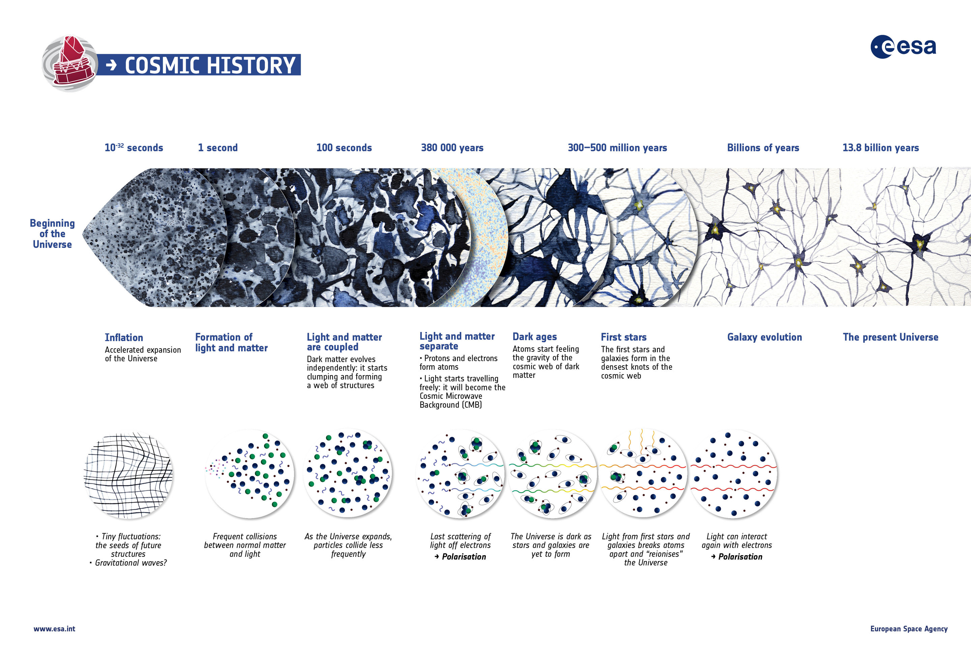



the story so far
primordial magnetic fields & gravitational waves
T > MeV
cosmic neutrino background
age 1s, T ~ MeV
cosmic microwave background (CMB)
z = 1089, age ~ 380 Kyrs
early Universe could answer some of the biggest questions:
Quantum gravity?
inflation?
baryon-antibaryon asymmetry?
dark matter?
galaxies
z = 14, age ~ 0.5 Gyrs
stars
z = 1.5, age ~ 5 Gyrs
Big Bang
following slides adapted from those of J. Schober
-32
5
10 s
10 K
0.01 ly
3 min
10 K
1 ly
4x10 yr
3000 K
3x10 ly
300-500 Myr
30 K
3x10 ly
13.6 Gyr
3 K
5x10 ly
27
9
7
9
10

Slide 5
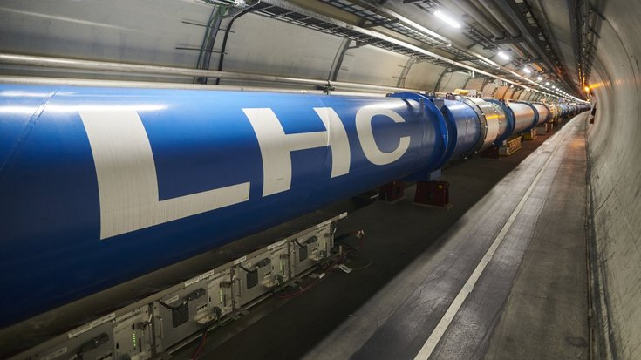
astroparticle physics
this physics is tested in particle accelerators
Large-Hadron Collider (LHC) © N. S. J. Hertzog, CERN
Big Bang
-32
5
10 s
10 K
0.01 ly
3 min
10 K
1 ly
4x10 yr
3000 K
3x10 ly
300-500 Myr
30 K
3x10 ly
13.6 Gyr
3 K
5x10 ly
27
9
7
9
10

Slide 6
the story so far
primordial magnetic fields & gravitational waves
T > MeV
cosmic neutrino background
age 1s, T ~ MeV
cosmic microwave background (CMB)
z = 1089, age ~ 380 Kyrs
early Universe could answer some of the biggest questions:
Quantum gravity?
inflation?
baryon-antibaryon asymmetry?
dark matter?
galaxies
z = 14, age ~ 0.5 Gyrs
stars
z = 1.5, age ~ 5 Gyrs
Big Bang
-32
5
10 s
10 K
0.01 ly
3 min
10 K
1 ly
4x10 yr
3000 K
3x10 ly
300-500 Myr
30 K
3x10 ly
13.6 Gyr
3 K
5x10 ly
27
9
7
9
10

Slide 7
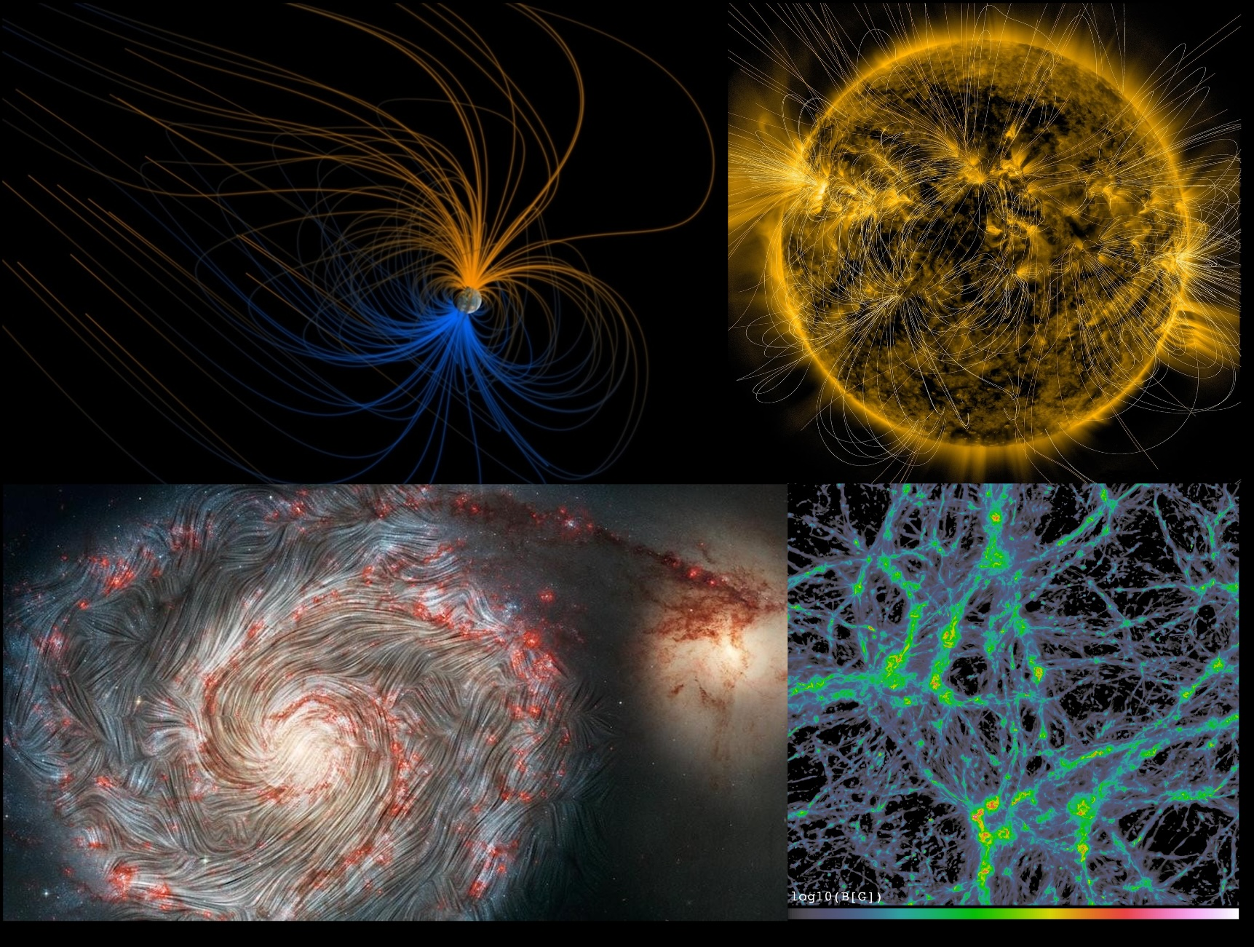
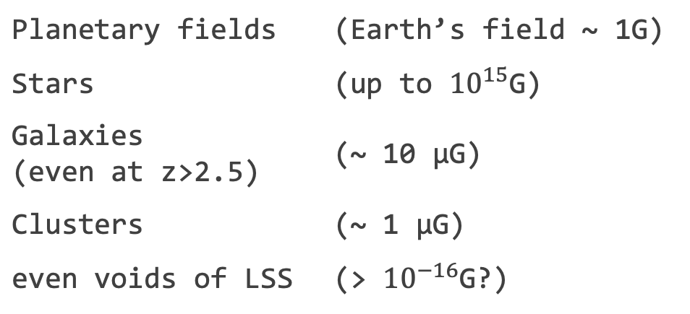
why else consider magnetic fields?
magnetic fields are ubiquituous
possible cosmological effects
  GWs, CMB distortions, matter spectrum, Hubble tension?
Planetary fields | (Earth’s field ~ 1G)
Stars | (up to ${10}^{15}$G)
Galaxies (even at z>2.5) | (~ 10 μG)
Clusters | (~ 1 μG)
even voids of LSS | (> ${10}^{−16}$G?)
(from top left, clockwise) Greg Shirah and Tom Bridgman, NASA Goddard Space Flight Center Scientific Visualization Studio; NASA/SDO/AIA/LMSAL; NASA, SOFIA, HAWC+, Alejandro S. Borlaff; JPL-Caltech, ESA, Hubble; F. Vazza, M. Brüggen, C. Gheller, P. Wang

Slide 8
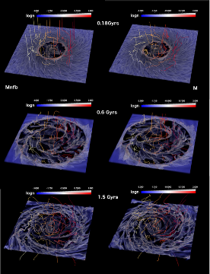
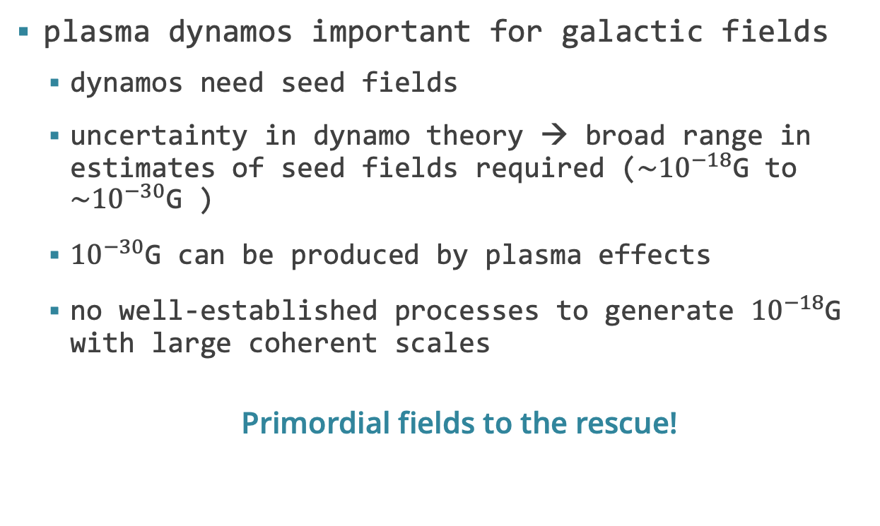
seed for galactic fields?
plasma dynamos important for galactic fields
  dynamos need seed fields
  uncertainty in dynamo theory → broad range in estimates of seed fields required ($\sim {10}^{−18}$G to $\sim {10}^{−30}$G )
  ${10}^{−30}$G can be produced by plasma effects
  no well-established processes to generate ${10}^{−18}$G with large coherent scales
  Primordial fields to the rescue!
E. Ntormousi et al 2020

Slide 9
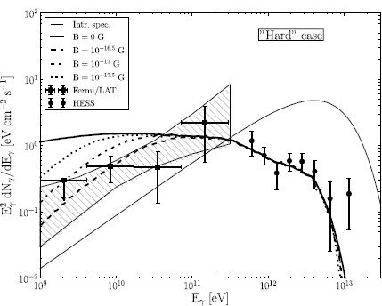
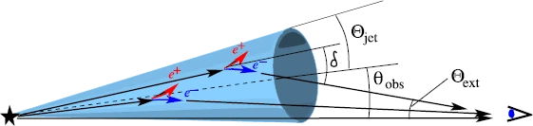
fields in the voids?
no GeV amplification observed!
Neronov et al 2010
Vovk et al 2012

Slide 10
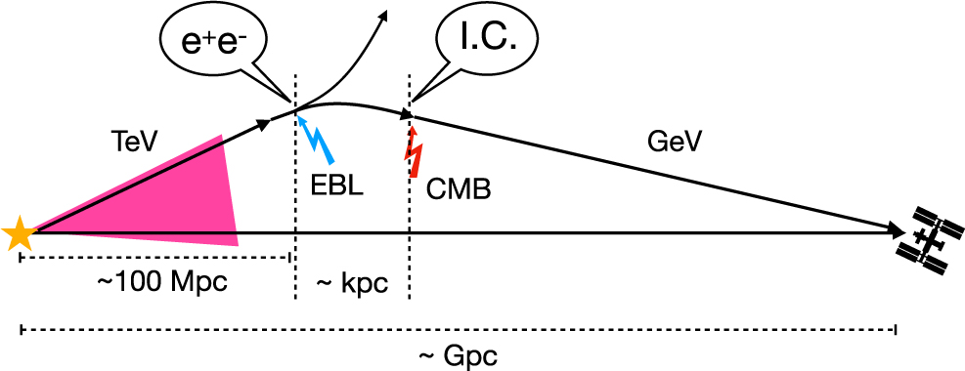
fields in the voids?
two possibilities
magnetic fields in voids
plasma instability
  heavily debated as beam density and energy very different
  GRBs could also hold the key
Vachaspati ‘21

Slide 11
could all the MFs be astrophysical?
galactic fields could possibly have astrophysical origins
  small scale dynamos could be important, requiring much weaker seed fields
  plasma battery effects could have generated such weak seed fields
blazar spectra could have astrophysical explanations
  plasma instabilities could play a role
  galactic winds or galactic dipoles, although reaching 70% filling factor could be difficult
primordial fields could help with both!
more observations needed!

Slide 12


magnetic history of the universe for primordial fields
Reviews:
Durrer & Neronov 2013
Subramanian 2016
Vachaspati 2020
MHD dynamos
Seed magnetic fields
Memory of primordial fields lost
Decaying MHD turbulence
Passive evolution
Fossils of the primordial field
Big Bang
-32
5
10 s
10 K
0.01 ly
3 min
10 K
1 ly
4x10 yr
3000 K
3x10 ly
300-500 Myr
30 K
3x10 ly
13.6 Gyr
3 K
5x10 ly
27
9
7
9
10

Slide 13
magnetic history of the universe for primordial fields
MHD dynamos
Chiral
MHD
Memory of primordial fields lost
Seed magnetic fields
Decaying MHD turbulence
Passive evolution
Fossils of the primordial field
Big Bang
-32
5
10 s
10 K
0.01 ly
3 min
10 K
1 ly
4x10 yr
3000 K
3x10 ly
300-500 Myr
30 K
3x10 ly
13.6 Gyr
3 K
5x10 ly
27
9
7
9
10

Slide 14
why is chiral mhd required?
Above observed upper limit
Chiral MHD
MHD
Magnetic field strength
Fundamental physics
Only MHD
Below observed lower limit
Time
Big Bang
-32
5
10 s
10 K
0.01 ly
3 min
10 K
1 ly
4x10 yr
3000 K
3x10 ly
300-500 Myr
30 K
3x10 ly
13.6 Gyr
3 K
5x10 ly
27
9
7
9
10

Slide 15
outline
introduction
what are chiral effects?
the rise of chiral mhd
chiral mhd in pencil-code

Slide 16
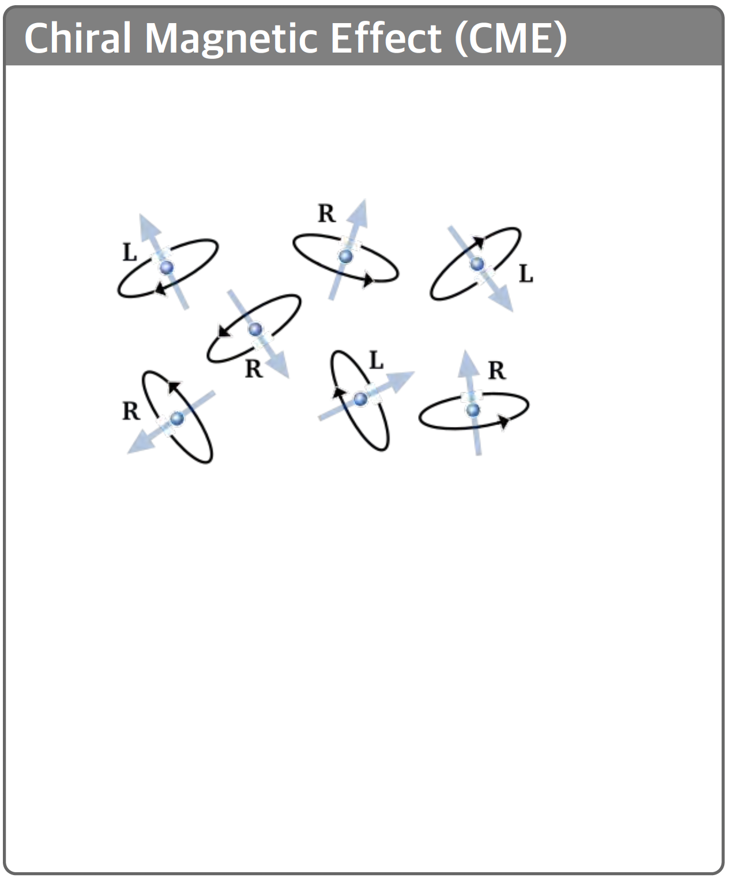
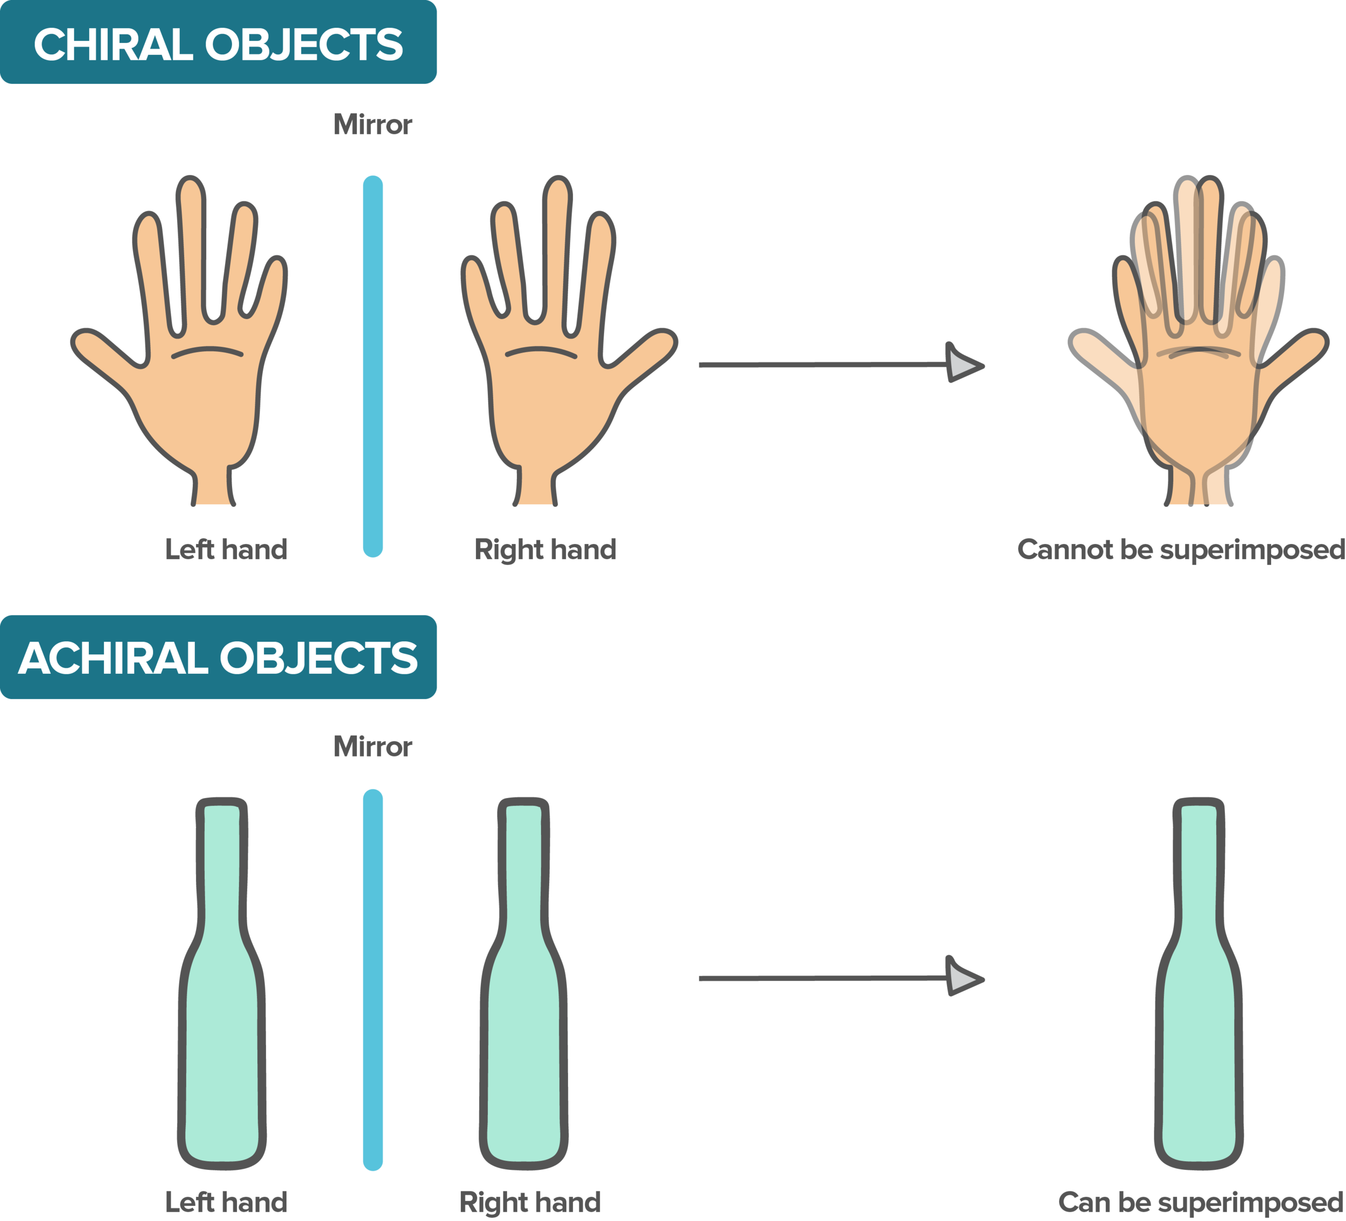
what is chirality?
Chiral fermions
Credit: mathwizurd; J. Schober

Slide 17
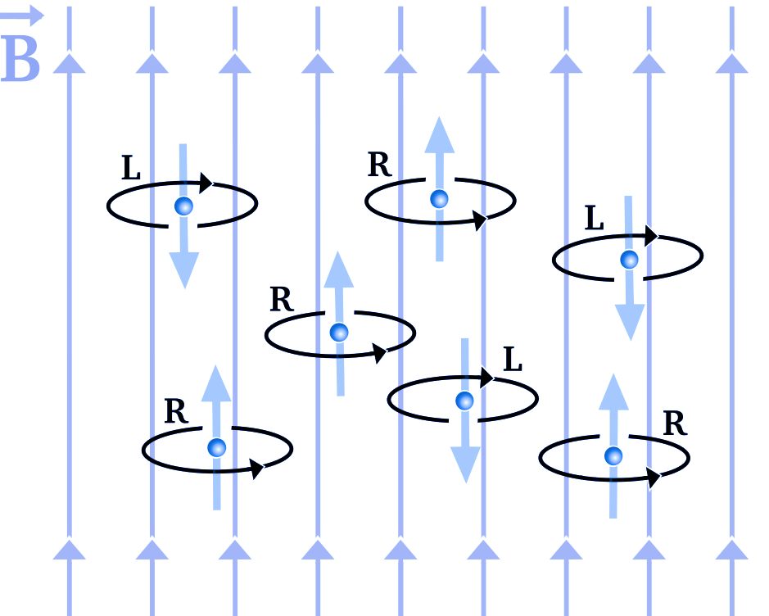

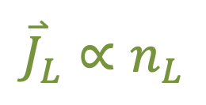
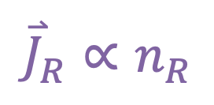
chiral magnetic effect
$${\overset{⃑}{J}}_{R}∝n_{R}$$
$${\overset{⃑}{J}}_{L}∝n_{L}$$
$${\overset{⃑}{J}}_{CME}∝n_{R}−n_{L},∥\overset{⃑}{B}$$
additional current enters MHD equations

Slide 18
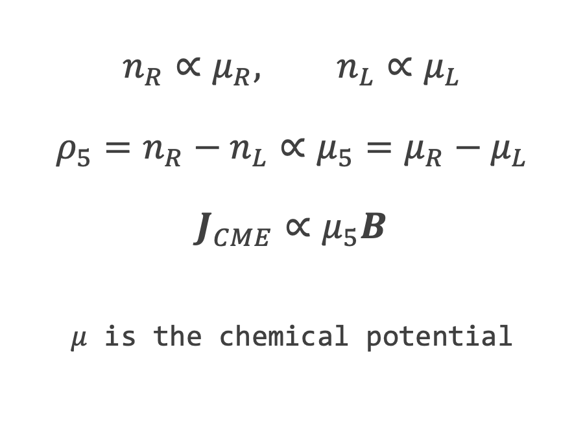
thermodynamics of chiral quantities
$$n_{R}∝μ_{R}, n_{L}∝μ_{L}$$
$$ρ_{5}=n_{R}−n_{L}∝μ_{5}=μ_{R}−μ_{L}$$
$$J_{CME}∝μ_{5}B$$
$μ$ is the chemical potential
Credit: Vilenkin 1980

Slide 19
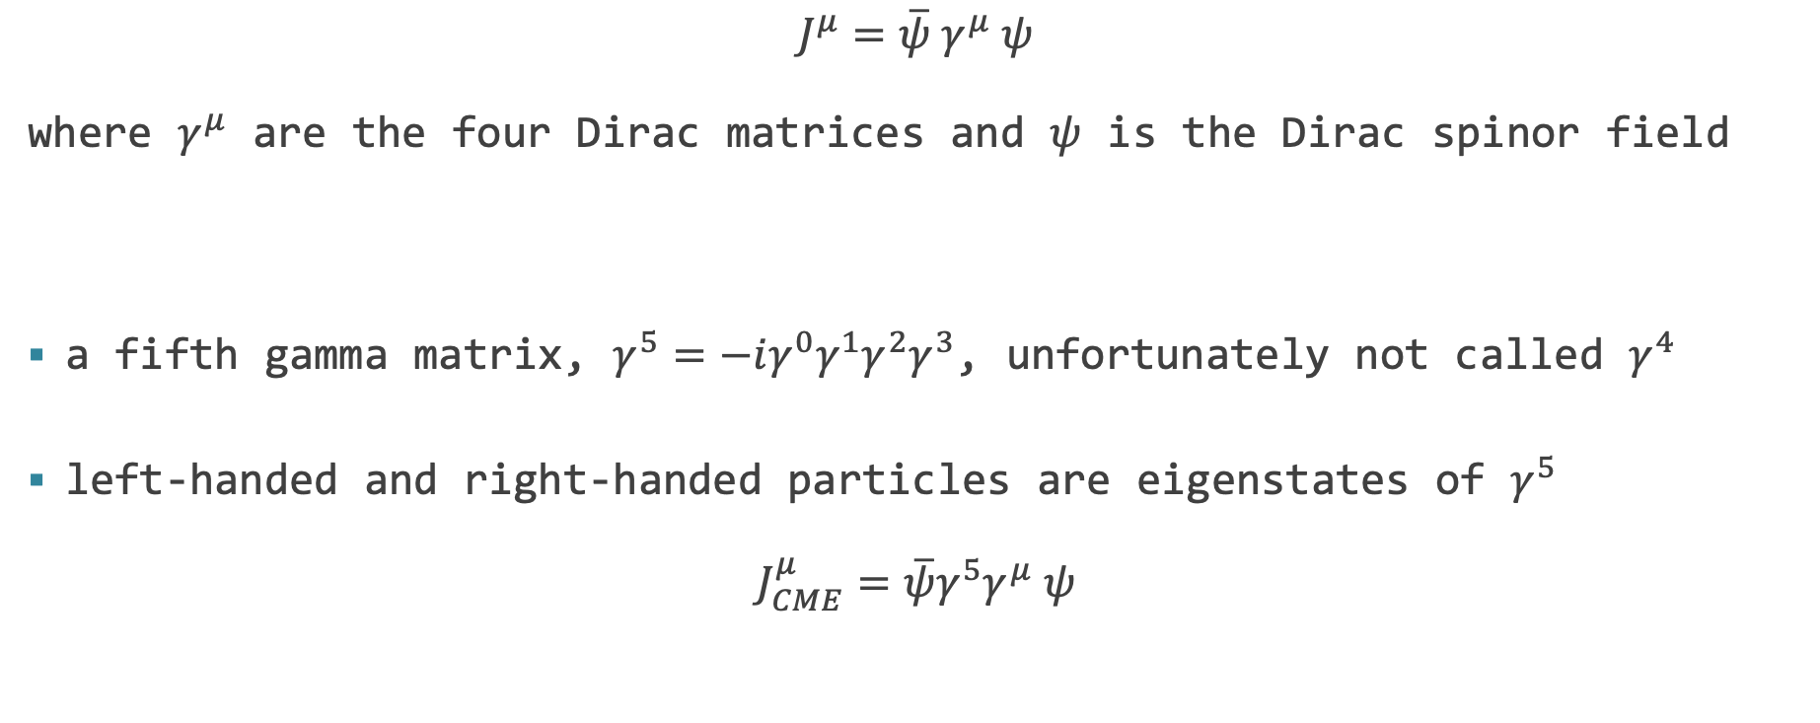
Quantum basis of these effects
$$J^{μ}=\overline{ψ} γ^{μ} ψ$$
where $γ^{μ}$ are the four Dirac matrices and $ψ$ is the Dirac spinor field
a fifth gamma matrix, $γ^{5}=−iγ^{0}γ^{1}γ^{2}γ^{3}$, unfortunately not called $γ^{4}$
left-handed and right-handed particles are eigenstates of $γ^{5}$
$$J_{CME}^{μ}=\overline{ψ}γ^{5}γ^{μ} ψ$$

Slide 20
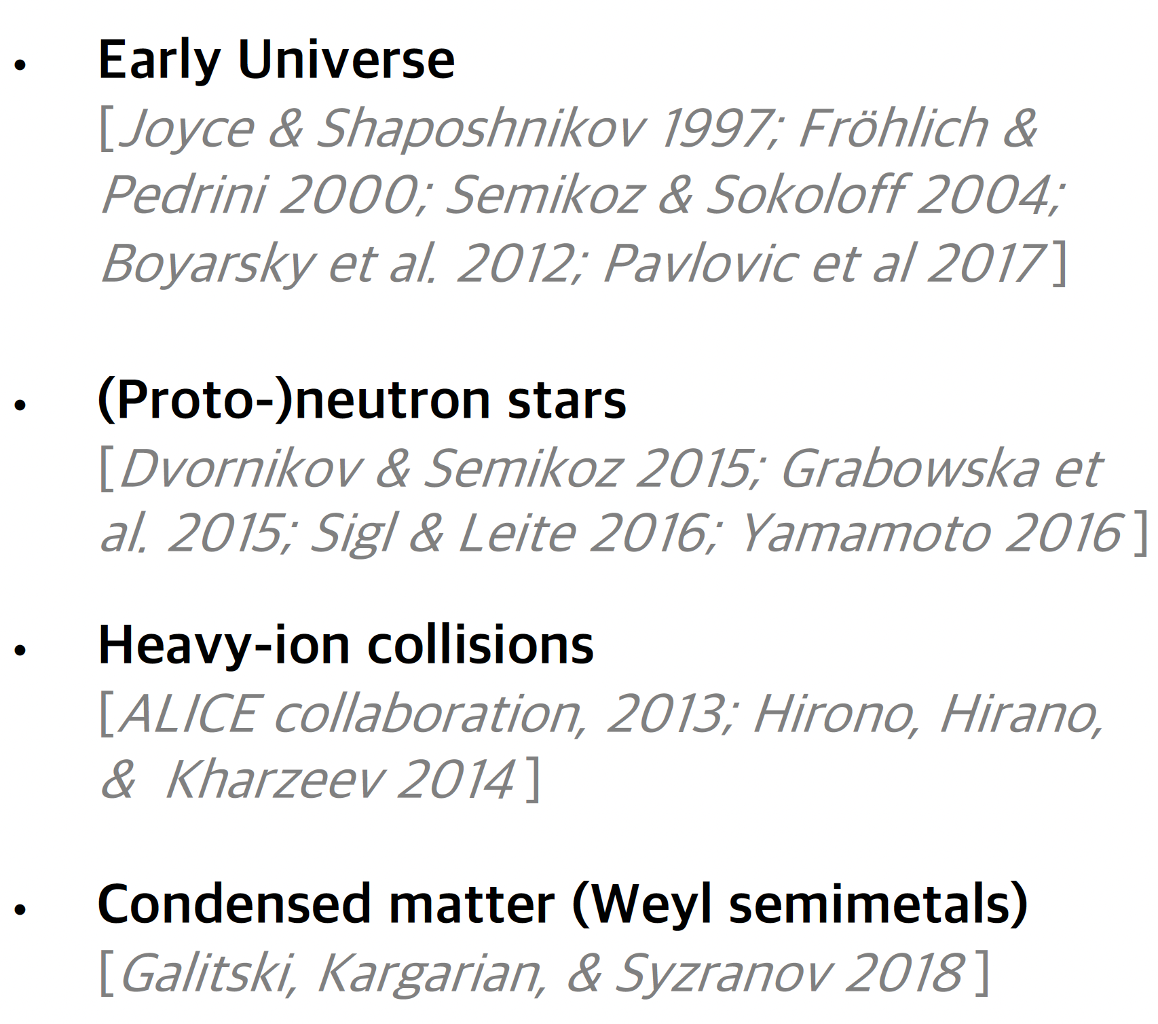
chiral effects relevant in many physical situations
usually relevant for high temperatures (T > 10 MeV at least)
we will shortly see why

Slide 21
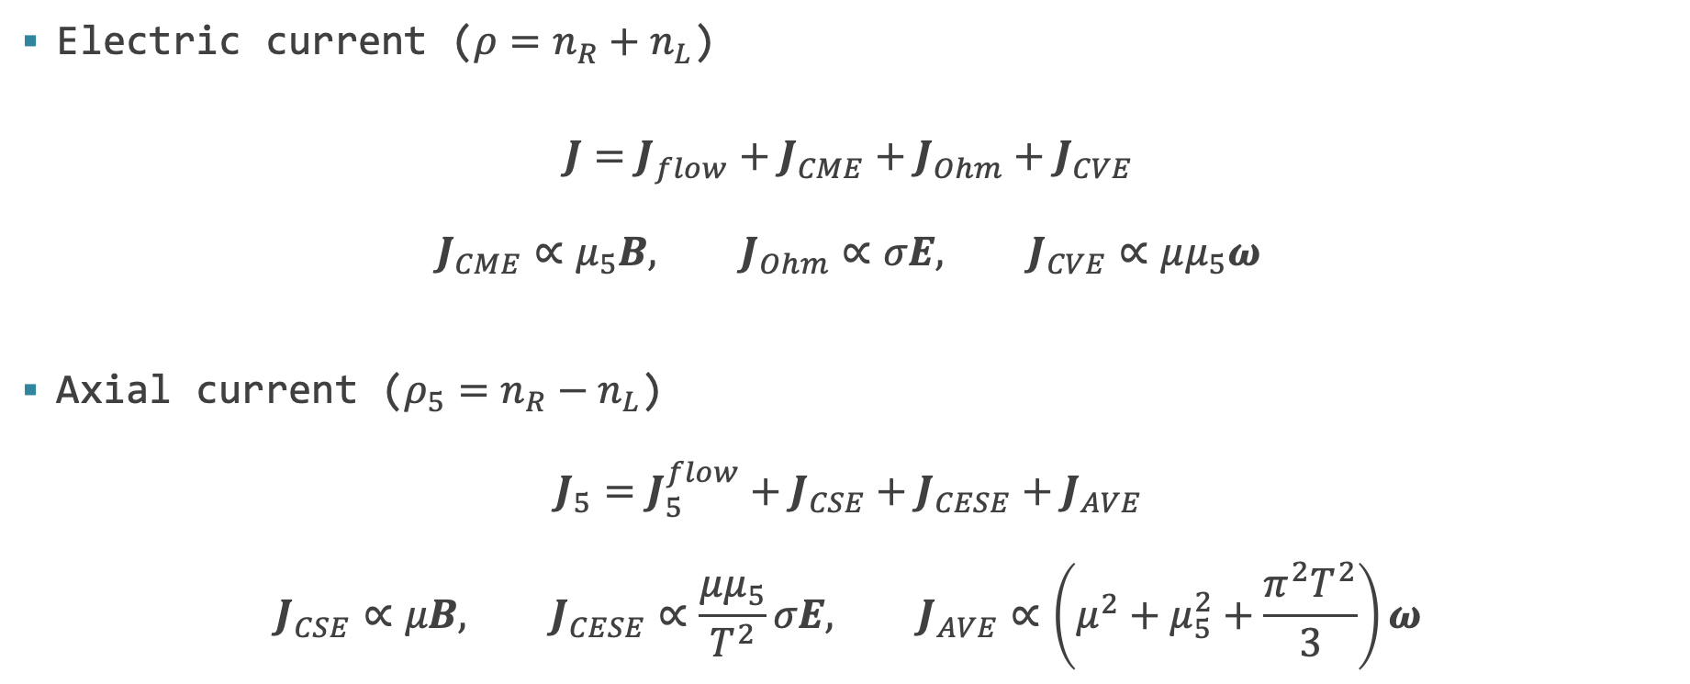
multiple kinds of chiral effects
Electric current ($ρ=n_{R}+n_{L}$)
$$J=J_{flow}+J_{CME}+J_{Ohm}+J_{CVE}$$
$$J_{CME}∝μ_{5}B, J_{Ohm}∝σE, J_{CVE}∝μμ_{5}ω$$
Axial current ($ρ_{5}=n_{R}−n_{L}$)
$$J_{5}=J_{5}^{flow}+J_{CSE}+J_{CESE}+J_{AVE}$$
$$J_{CSE}∝μB, J_{CESE}∝\frac{μμ_{5}}{T^{2}}σE, J_{AVE}∝\left(μ^{2}+μ_{5}^{2}+\frac{π^{2}T^{2}}{3}\right)ω$$
quasineutrality
neglected here
neglected here

Slide 22
outline
introduction
what are chiral effects?
the rise of chiral mhd
chiral mhd in pencil-code

Slide 23

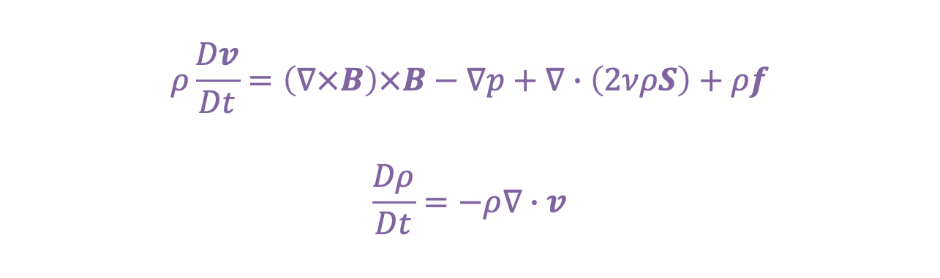
chiral current enters the induction equation
$$ρ\frac{Dv}{Dt}=\left(∇×B\right)×B−∇p+∇∙\left(2νρS\right)+ρf$$
$$\frac{Dρ}{Dt}=−ρ∇∙v$$
unchanged
$$E=−v×B+η\left(∇×B−μ_{5}B\right)$$
$$\frac{∂B}{∂t}=∇×\left[v×B−η\left(∇×B−μ_{5}B\right)\right]$$

Slide 24


equation for $μ_{5}$
$$\frac{∂μ_{5}}{∂t}+∇∙\left(μ_{5}v\right)=E∙B$$
Chiral Anomaly!
$$μ_{5}+A∙B=constant$$

Slide 25
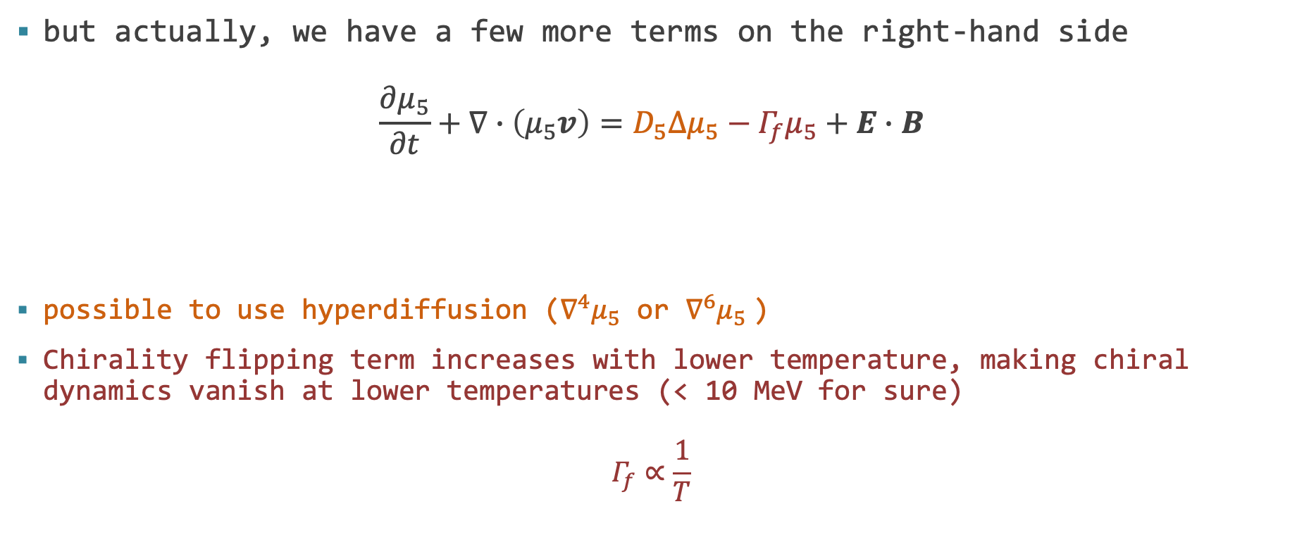
equation for $μ_{5}$
but actually, we have a few more terms on the right-hand side
$$\frac{∂μ_{5}}{∂t}+∇∙\left(μ_{5}v\right)=D_{5}Δμ_{5}−Γ_{f}μ_{5}+E∙B$$
possible to use hyperdiffusion ($∇^{4}μ_{5}$ or $∇^{6}μ_{5}$)
Chirality flipping term increases with lower temperature, making chiral dynamics vanish at lower temperatures (< 10 MeV for sure)
$$Γ_{f}∝\frac{1}{T}$$
Diffusion
(put in by hand)
Chirality flipping

Slide 26

“all” equations of chiral mhd
$$ρ\frac{Dv}{Dt}=\left(∇×B\right)×B−∇p+∇∙\left(2νρS\right)+ρf$$
$$\frac{Dρ}{Dt}=−ρ∇∙v$$
$$E=−v×B+η\left(∇×B−μ_{5}B\right)$$
$$\frac{∂B}{∂t}=∇×\left[v×B−η\left(∇×B−μ_{5}B\right)\right]$$
$$\frac{∂μ_{5}}{∂t}+∇∙\left(μ_{5}v\right)=D_{5}Δμ_{5}+η\left[\left(∇×B\right)∙B−μ_{5}B^{2}\right]$$
not quite “all” though…

Slide 27
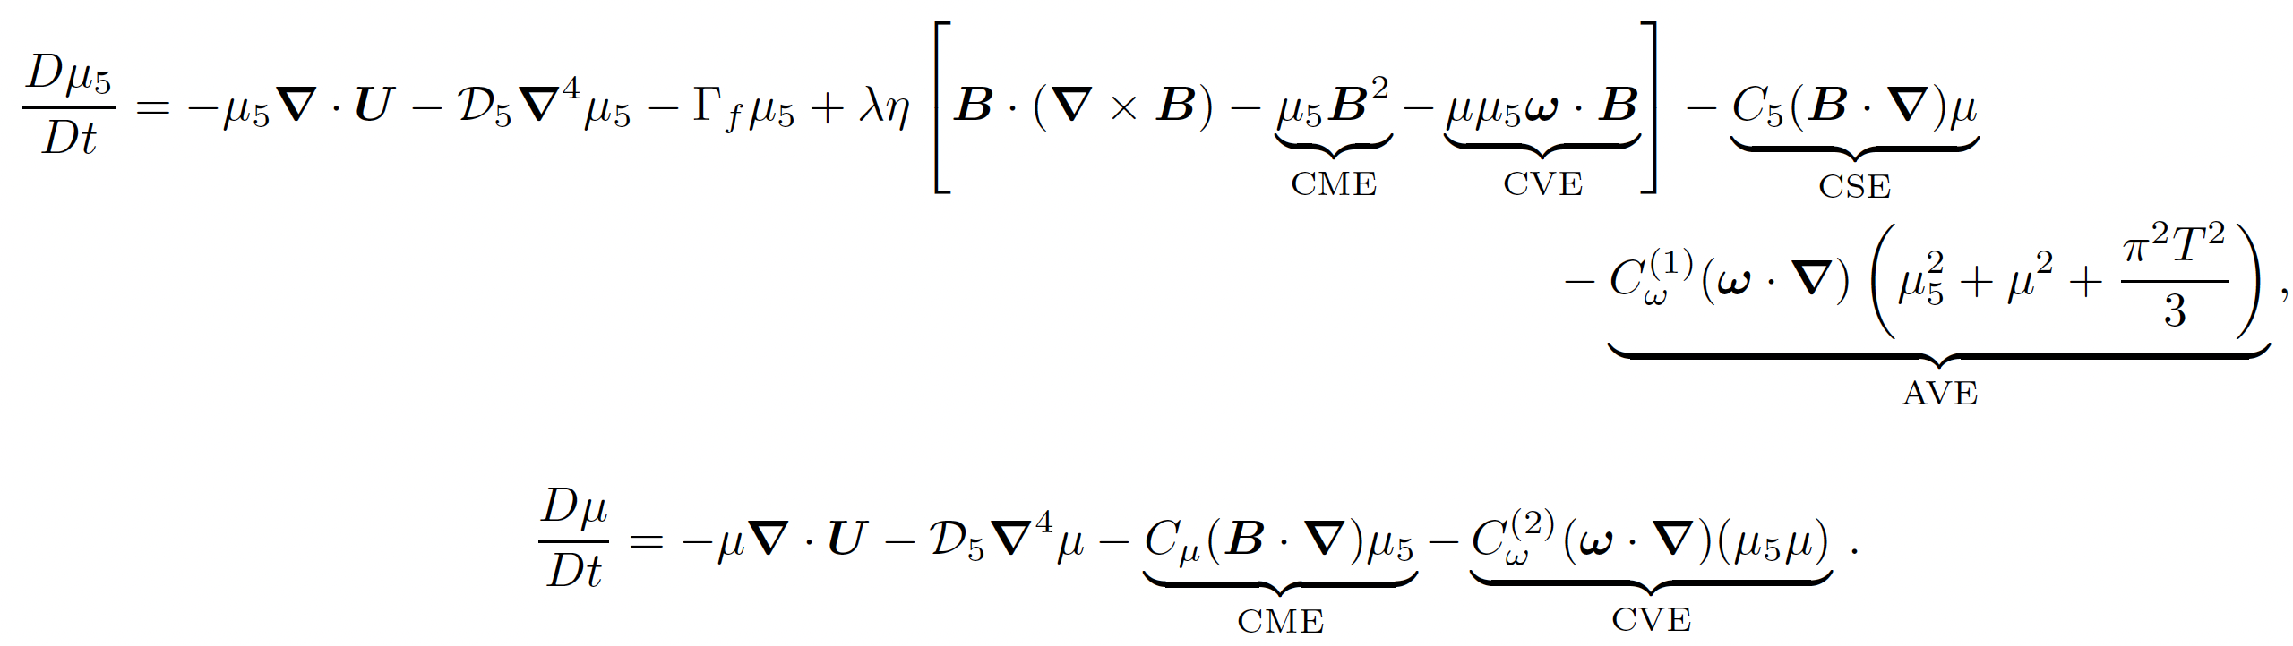
full set of equations for the chemical potentials

Slide 28
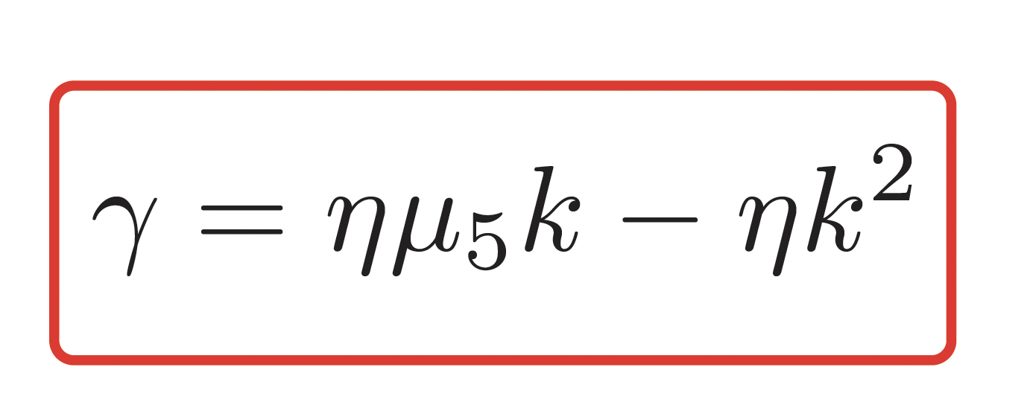
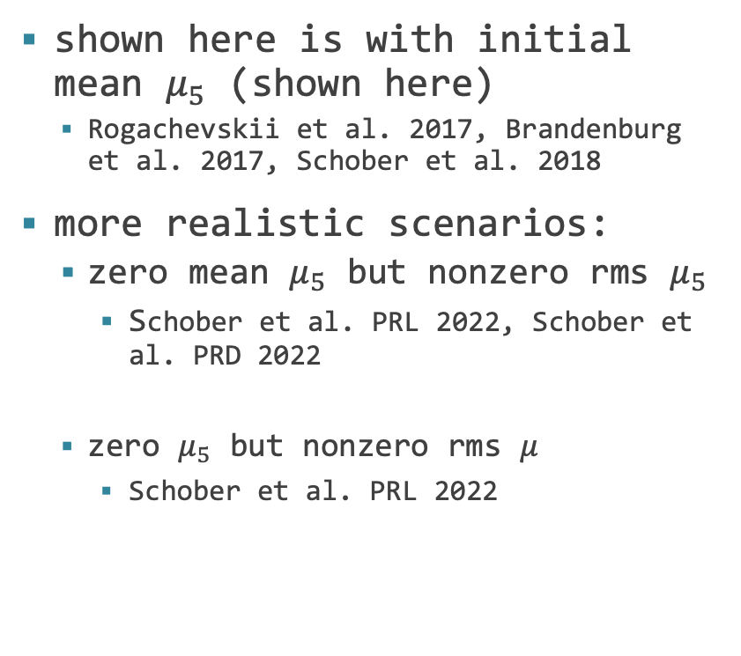
why do we care? a Standard Model dynamo!
shown here is with initial mean $μ_{5}$ (shown here)
  Rogachevskii et al. 2017, Brandenburg et al. 2017, Schober et al. 2018
more realistic scenarios:
  zero mean $μ_{5}$ but nonzero rms $μ_{5}$
    Schober et al. PRL 2022, Schober et al. PRD 2022
  zero $μ_{5}$ but nonzero rms $μ$
    Schober et al. PRL 2022

Slide 29
outline
introduction
what are chiral effects?
the rise of chiral mhd
chiral mhd in pencil-code

Slide 30
chiral module in pencil
Let’s look at the chiral module in pencil-code!

Slide 31
thank you!

